Slide 1
Notes:
Emphasise that every athlete participating in a BUCS competition this year must create a BUCS Play account to be eligible

Slide 2
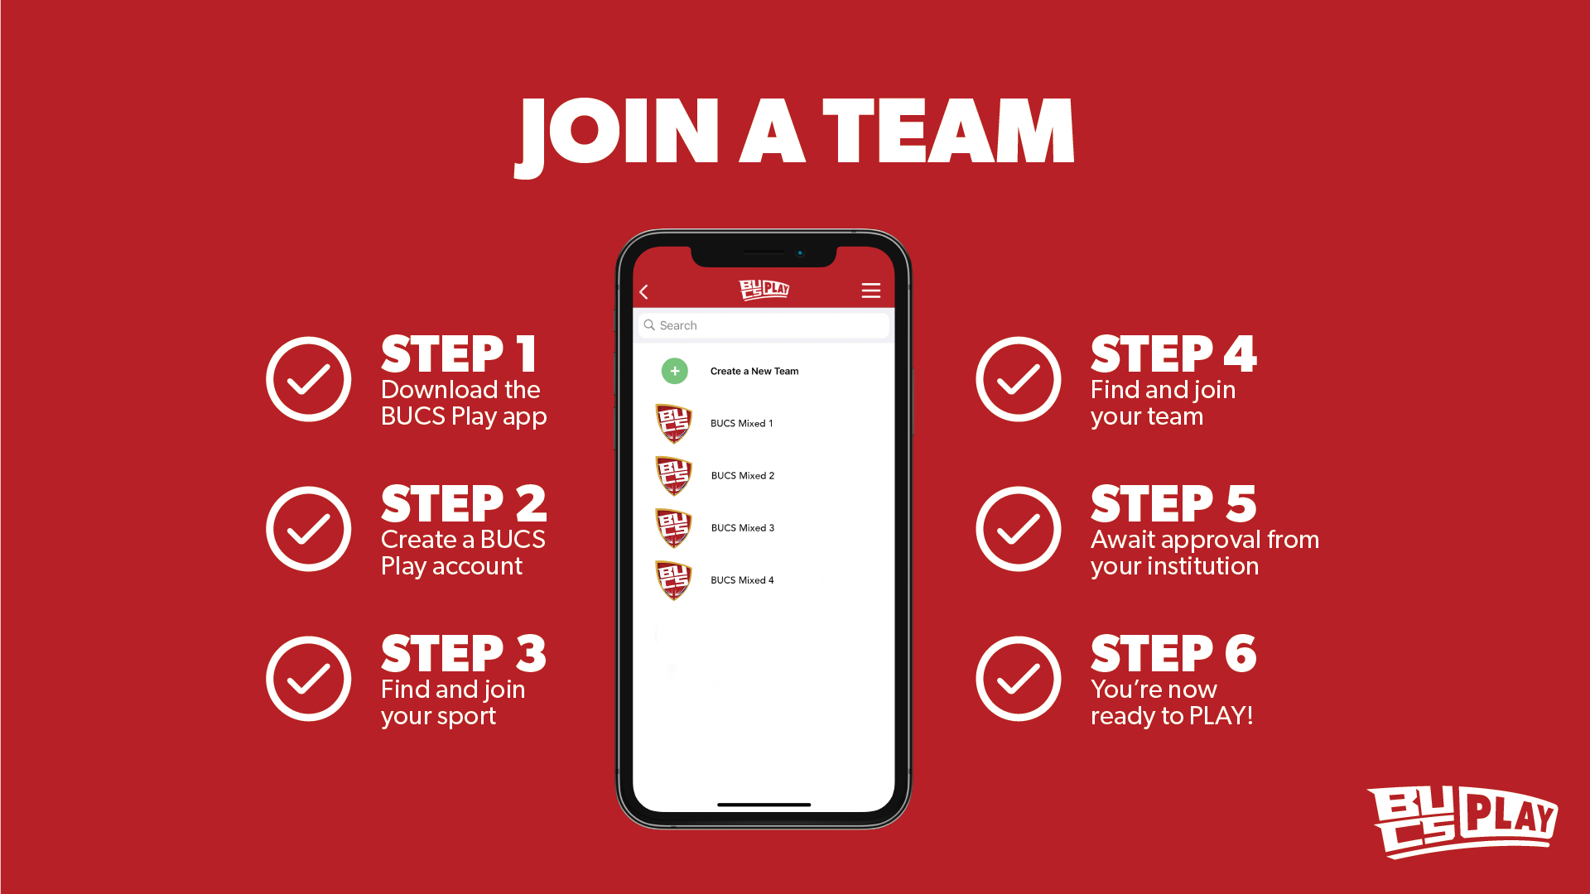
Notes:
Tell your team to do this – same process as you did to become a captain

Slide 4
Notes:
These are the areas a team captain is now responsible for. Emphasise that this has changed from previews years/the process has now changed.

Slide 5
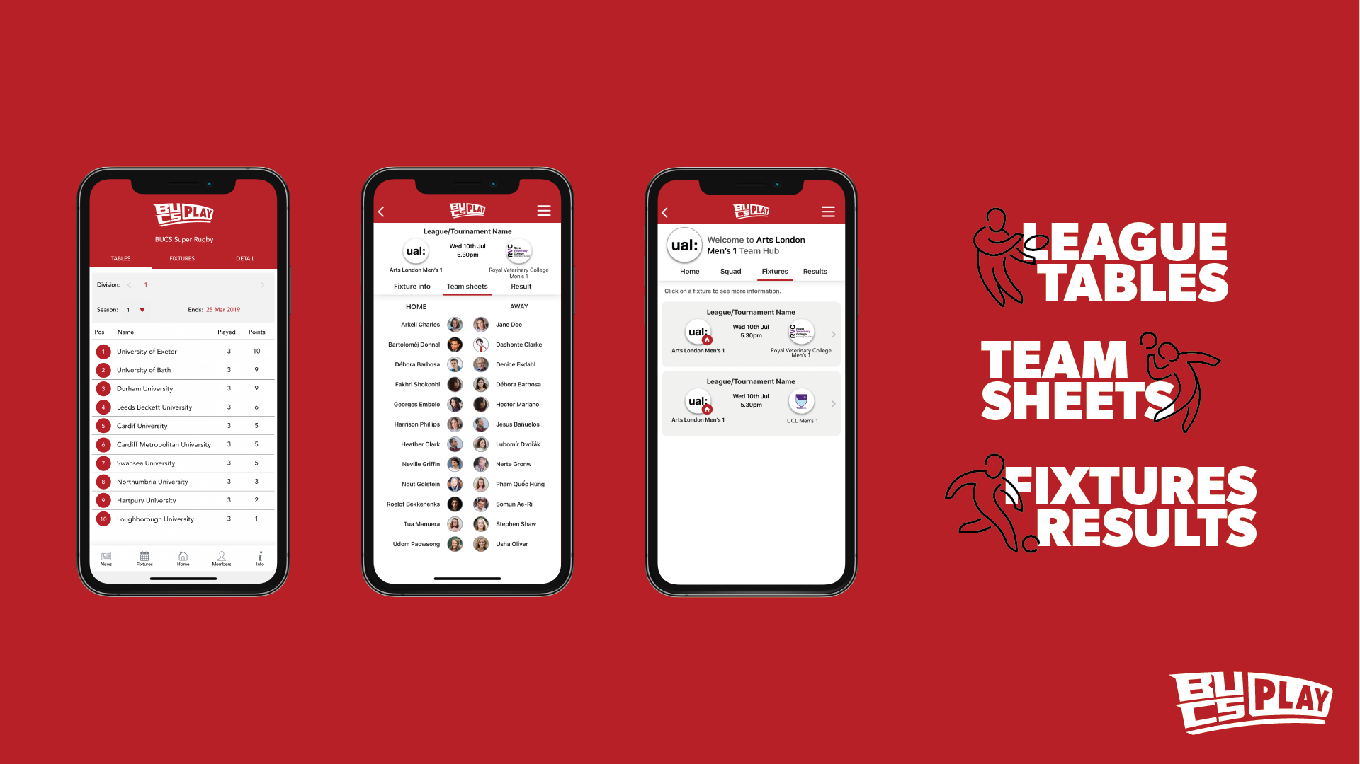
Notes:
Examples of what the app looks like, pulling out the 3 key features that the app carries for league competitors

Slide 6
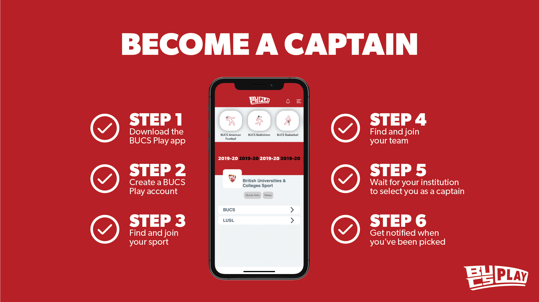
Notes:
Get all captains to take out their phones at this moment and download the BUCS Play app and follow these steps. Do not let anybody leave the training without having completed this task.

Slide 7
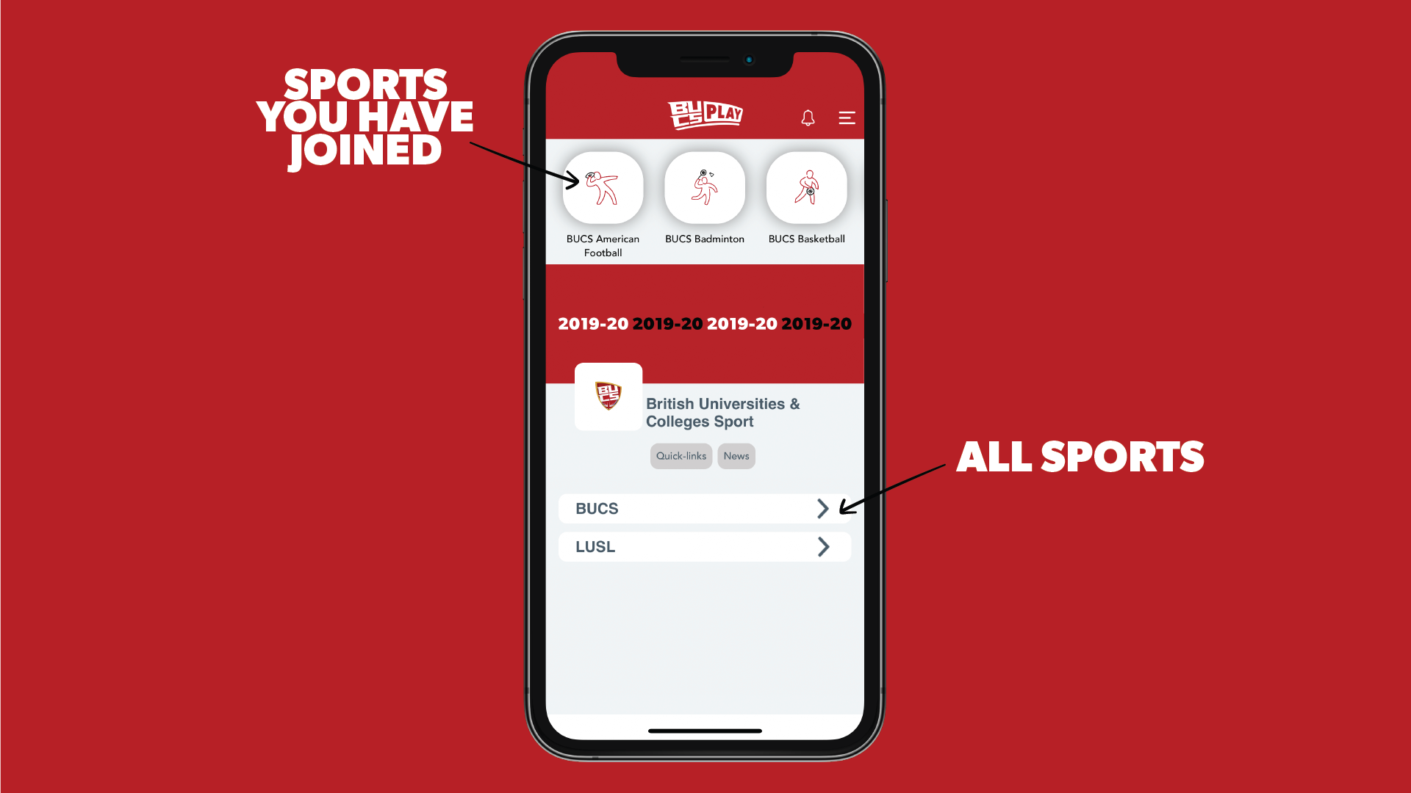
Notes:
App navigation – note: when you ‘join’ your sport (hidden in the BUCS tabs), it will appear at the top of the homepage giving you quick access to return to your sport community

Slide 8
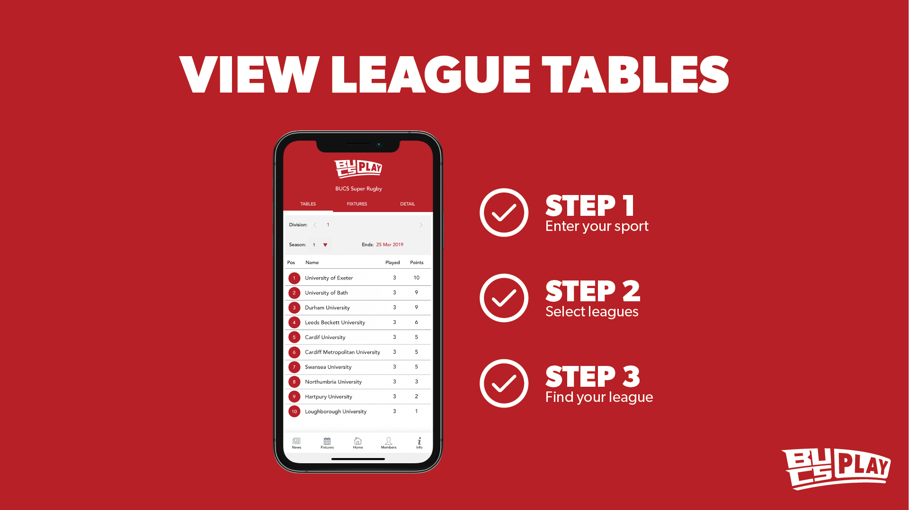
Notes:
Following slides show examples of how to navigate around some of BUCS Play’s key functionality

Slide 9
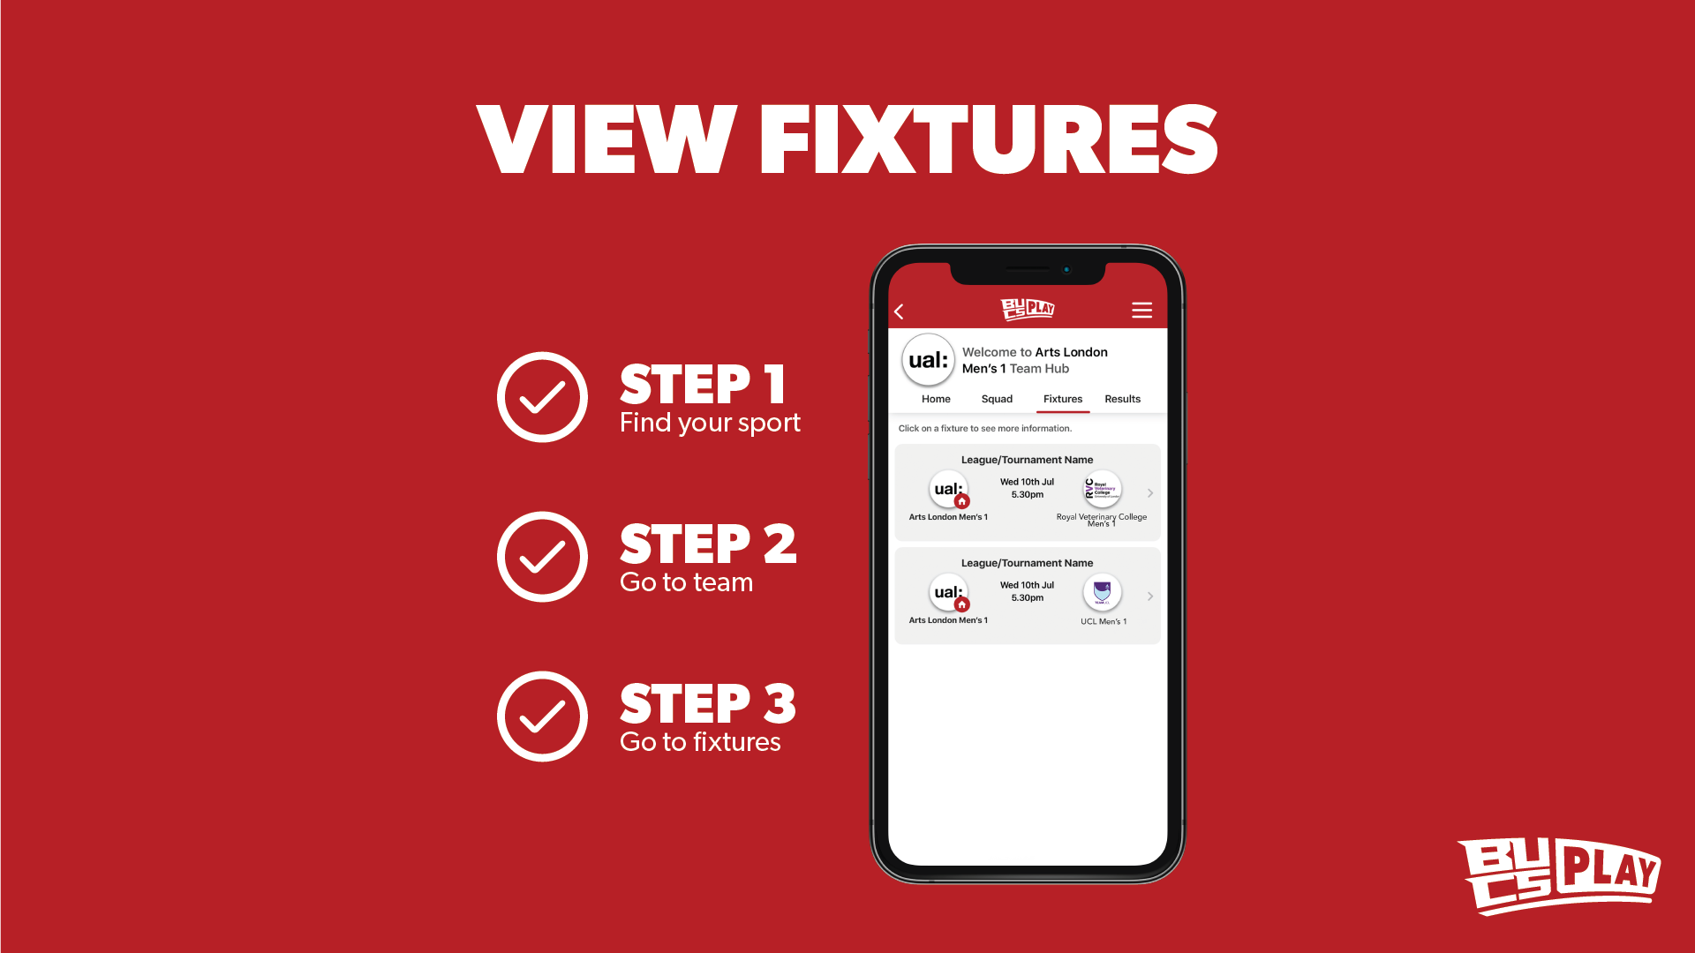

Slide 10
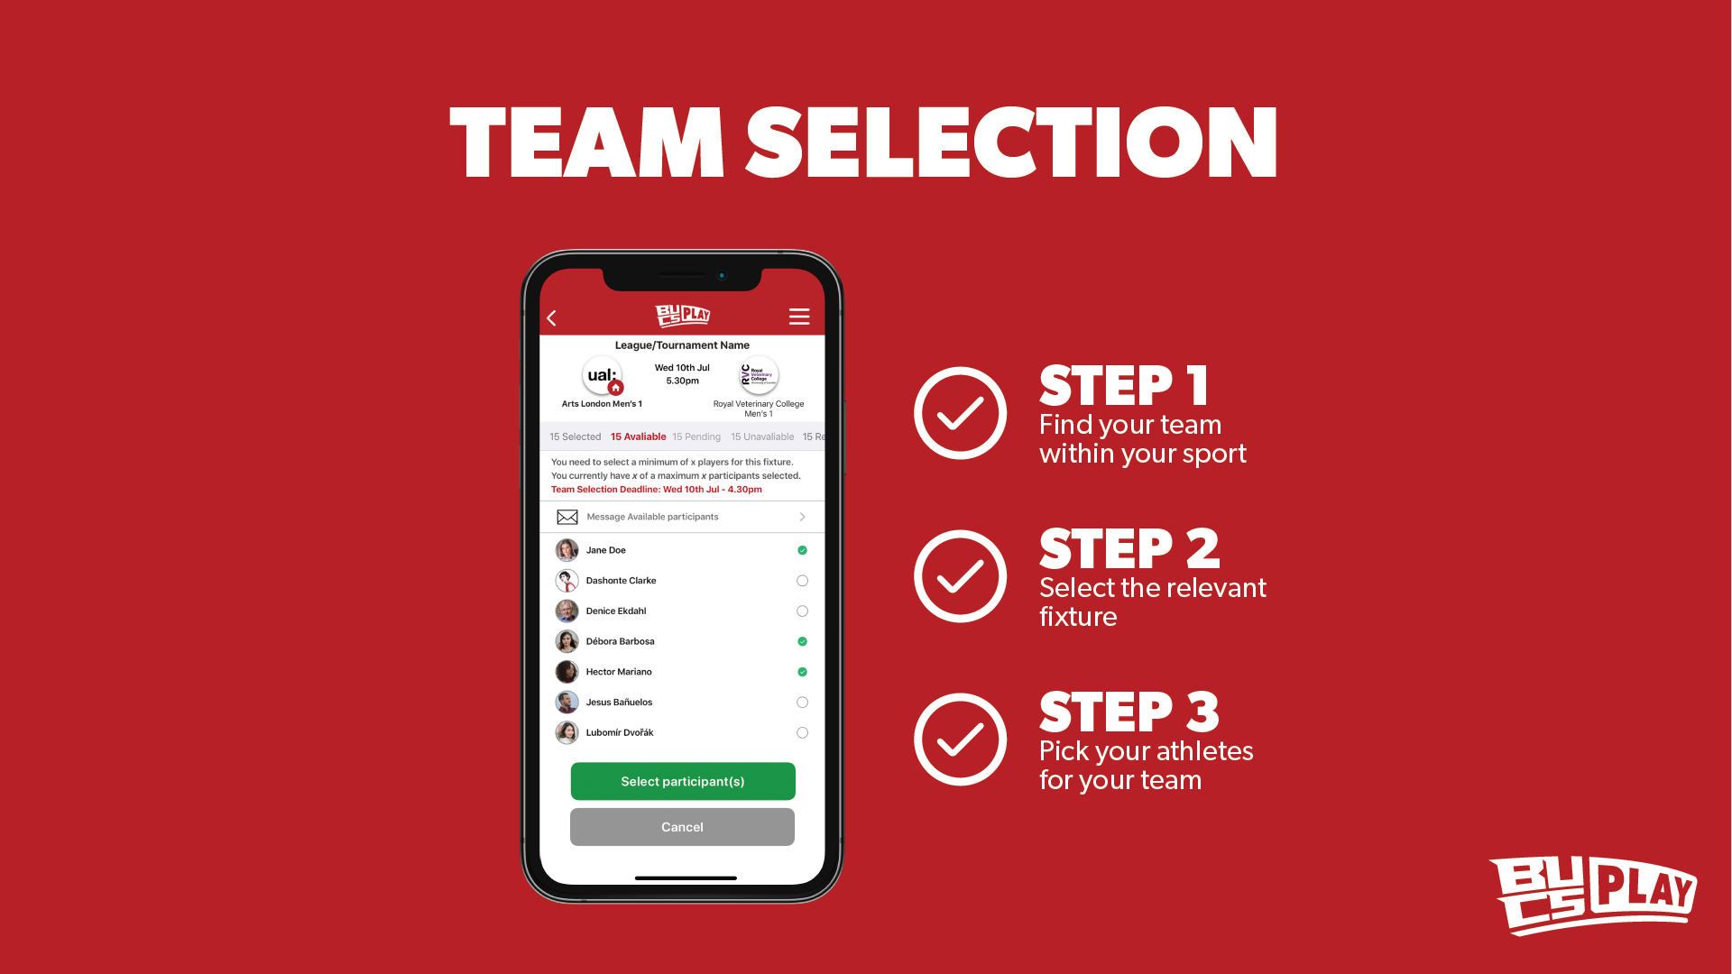

Slide 11
Notes:
FAQ at the end which answers what to do if they want to reject a team sheet

Slide 12
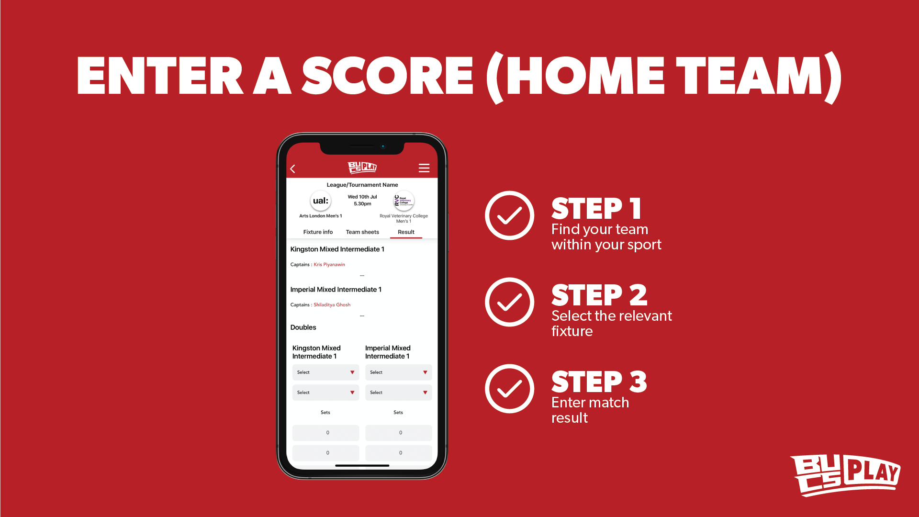
Notes:
Stress that only the home team needs to enter a score post-match

Slide 13
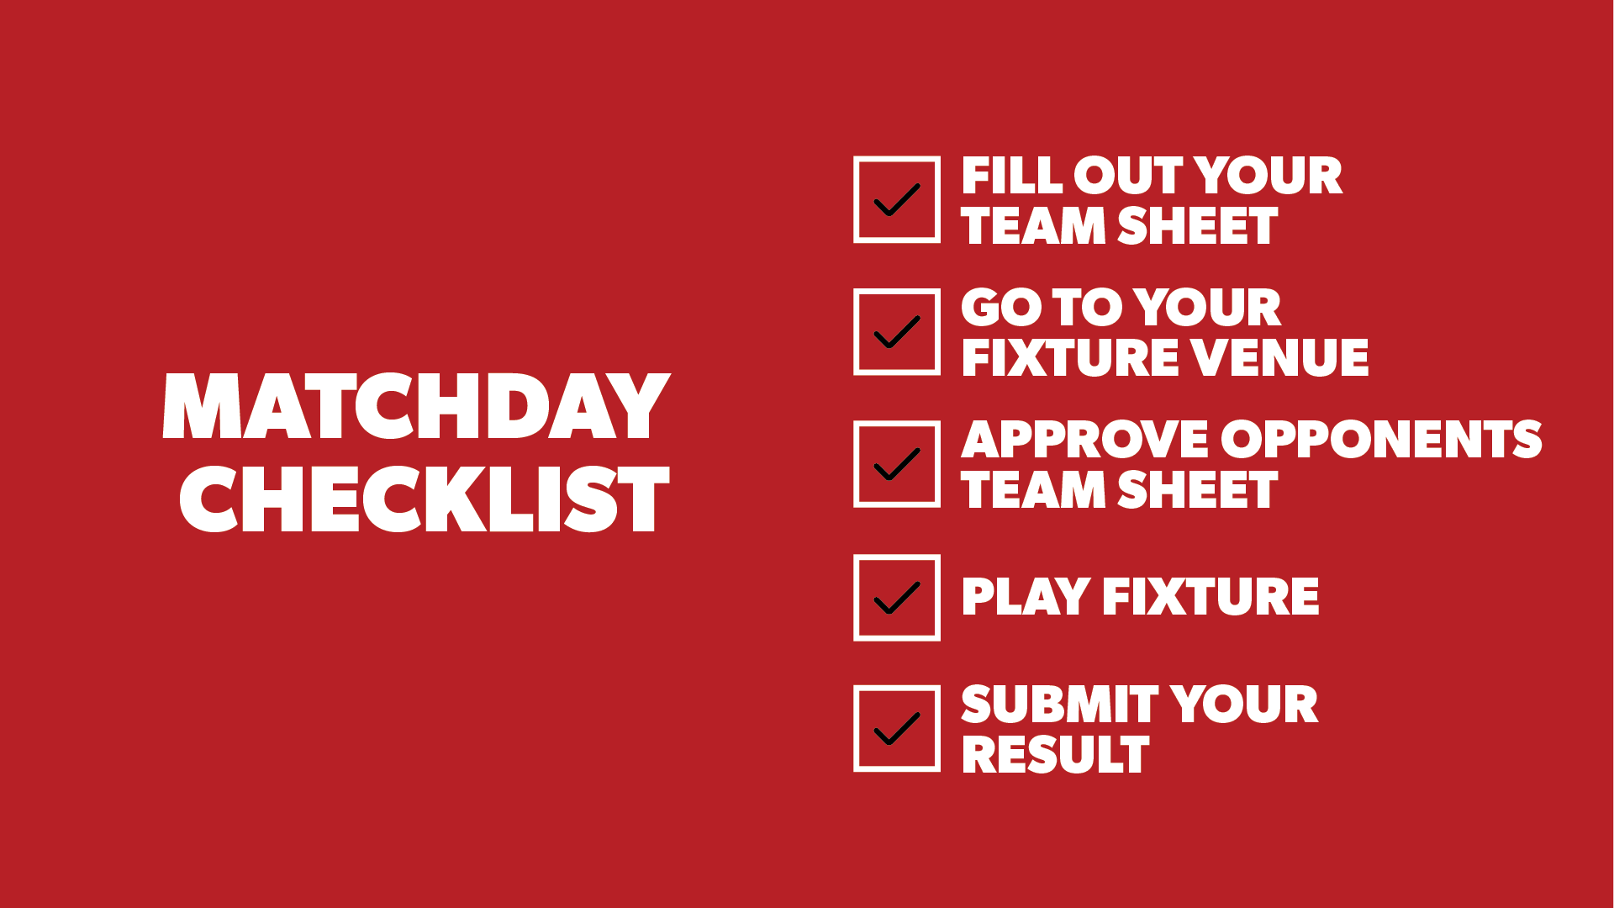

Slide 14
FOR ALL BUCS PLAY HELP GUIDES, PLEASE VISIT THE BUCS APP SUPPORT WEBSITE:
https://bucsappsupport.zendesk.com/hc/en-gb

